Slide 1
DSC 4310 Project 2
Enhancing Classification and Prediction Performance: SVM, d-index and Bagging-SVM
Authors: Devin Duran, Adam Abid, Seth Kacura

Slide 2
Objectives:
Part 1: We will create an SVM classifier and run it on the well-structured Iris dataset
Part 2: We will implement a bagging SVM for multiple datasets and compare its performance on these to a simple SVM

Slide 3


Part 1 - SVM Classification and Measures on the Iris Data

Slide 4
Overview
An SVM (support vector machine) separates observations by constructing a hyperplane in high dimensional space
The iris data contains 150 observations and five features
For the iris data, we will implement an SVM and compute the following metrics:
F1-micro, F1-macro, Balanced Accuracy, and ROC AUC Score
A long with these metrics we will also compute the diagnostic index (d-index) of the SVM as well

Slide 5
Metrics Overview
F1-micro: calculates the F1 score by considering global true positives, false negatives, and false positives; gives equal weight to each sample and each class
F1-macro: calculates the F1 score independently for each class and then takes the unweighted average of those scores; gives equal weight to each class
Balanced Accuracy: calculates accuracy of a classifier, taking class imbalance into account; arithmetic mean of sensitivity and specificity
ROC AUC Score: measures area under the roc curve, which plots the true positive rate against the false positive rate

Slide 6
Diagnostic Index
The diagnostic index or d-index is a measure of classification performance combining sensitivity (true positive rate) and specificity (true negative rate)
d_index is convenient for comparing ML results, and is also an effective measure to reflect the true ML status in imbalanced learning
Its formula is given by d = log₂(1 + accuracy) + log₂(1 + (sensitivity + specificity)/2)
The value of d-index can be anywhere between 1.33 and 2; if it reaches 1.8, then it is a good score
A d-index less than 1.8 generally means “chance level” classification
A d-index can sometimes be less than 1 in special cases; this means that classification is very poor

Slide 7
Kernels
Kernels in SVM map two classes of data points in a lower dimensional feature space onto a high-dimensional space so that the two sets of data points can be separated using a hyperplane
The four general kernel functions are:
Linear: creates a straight line decision boundary to separate classes; default kernel, best to use when data is linear
RBF: places a radial basis function centered at each point, then perform linear manipulations to map points to higher-dimensional spaces that are easier to separate
Poly: represents the similarity of vectors in a feature space over polynomials of the original variables, allowing learning of non-linear models
Sigmoid: controls the influence of each individual training sample on the decision boundary and is the bias term shifting the data up or down
We will run an SVM using each of these kernels and observe the d-index and metrics for them

Slide 8
Data Import and Training
We import any packages we need and the iris data from sklearn
We then get our data and target X and y before splitting them in training and testing data
For this part of the analysis we split it into 70% training and 30% testing
The training dataset will contain 105 observations and the testing will have 45
We normalize our data using MaxAbsScaler
We pick this method because it is the best when data is well-structured like the iris data we are working with

Slide 9
SVM Classifier
For each kernel we run our SVM classifier and take their metrics and d-index
To get our d-index, we need to know the accuracy, sensitivity, and specificity of our model so we calculate those as well
We print out a visualization of the confusion matrix, which predicts the variety (setosa, versicolor or virginica) of an iris flower for the test data which contains 45 observations
We create a long for-loop that does all of this for each kernel

Slide 10
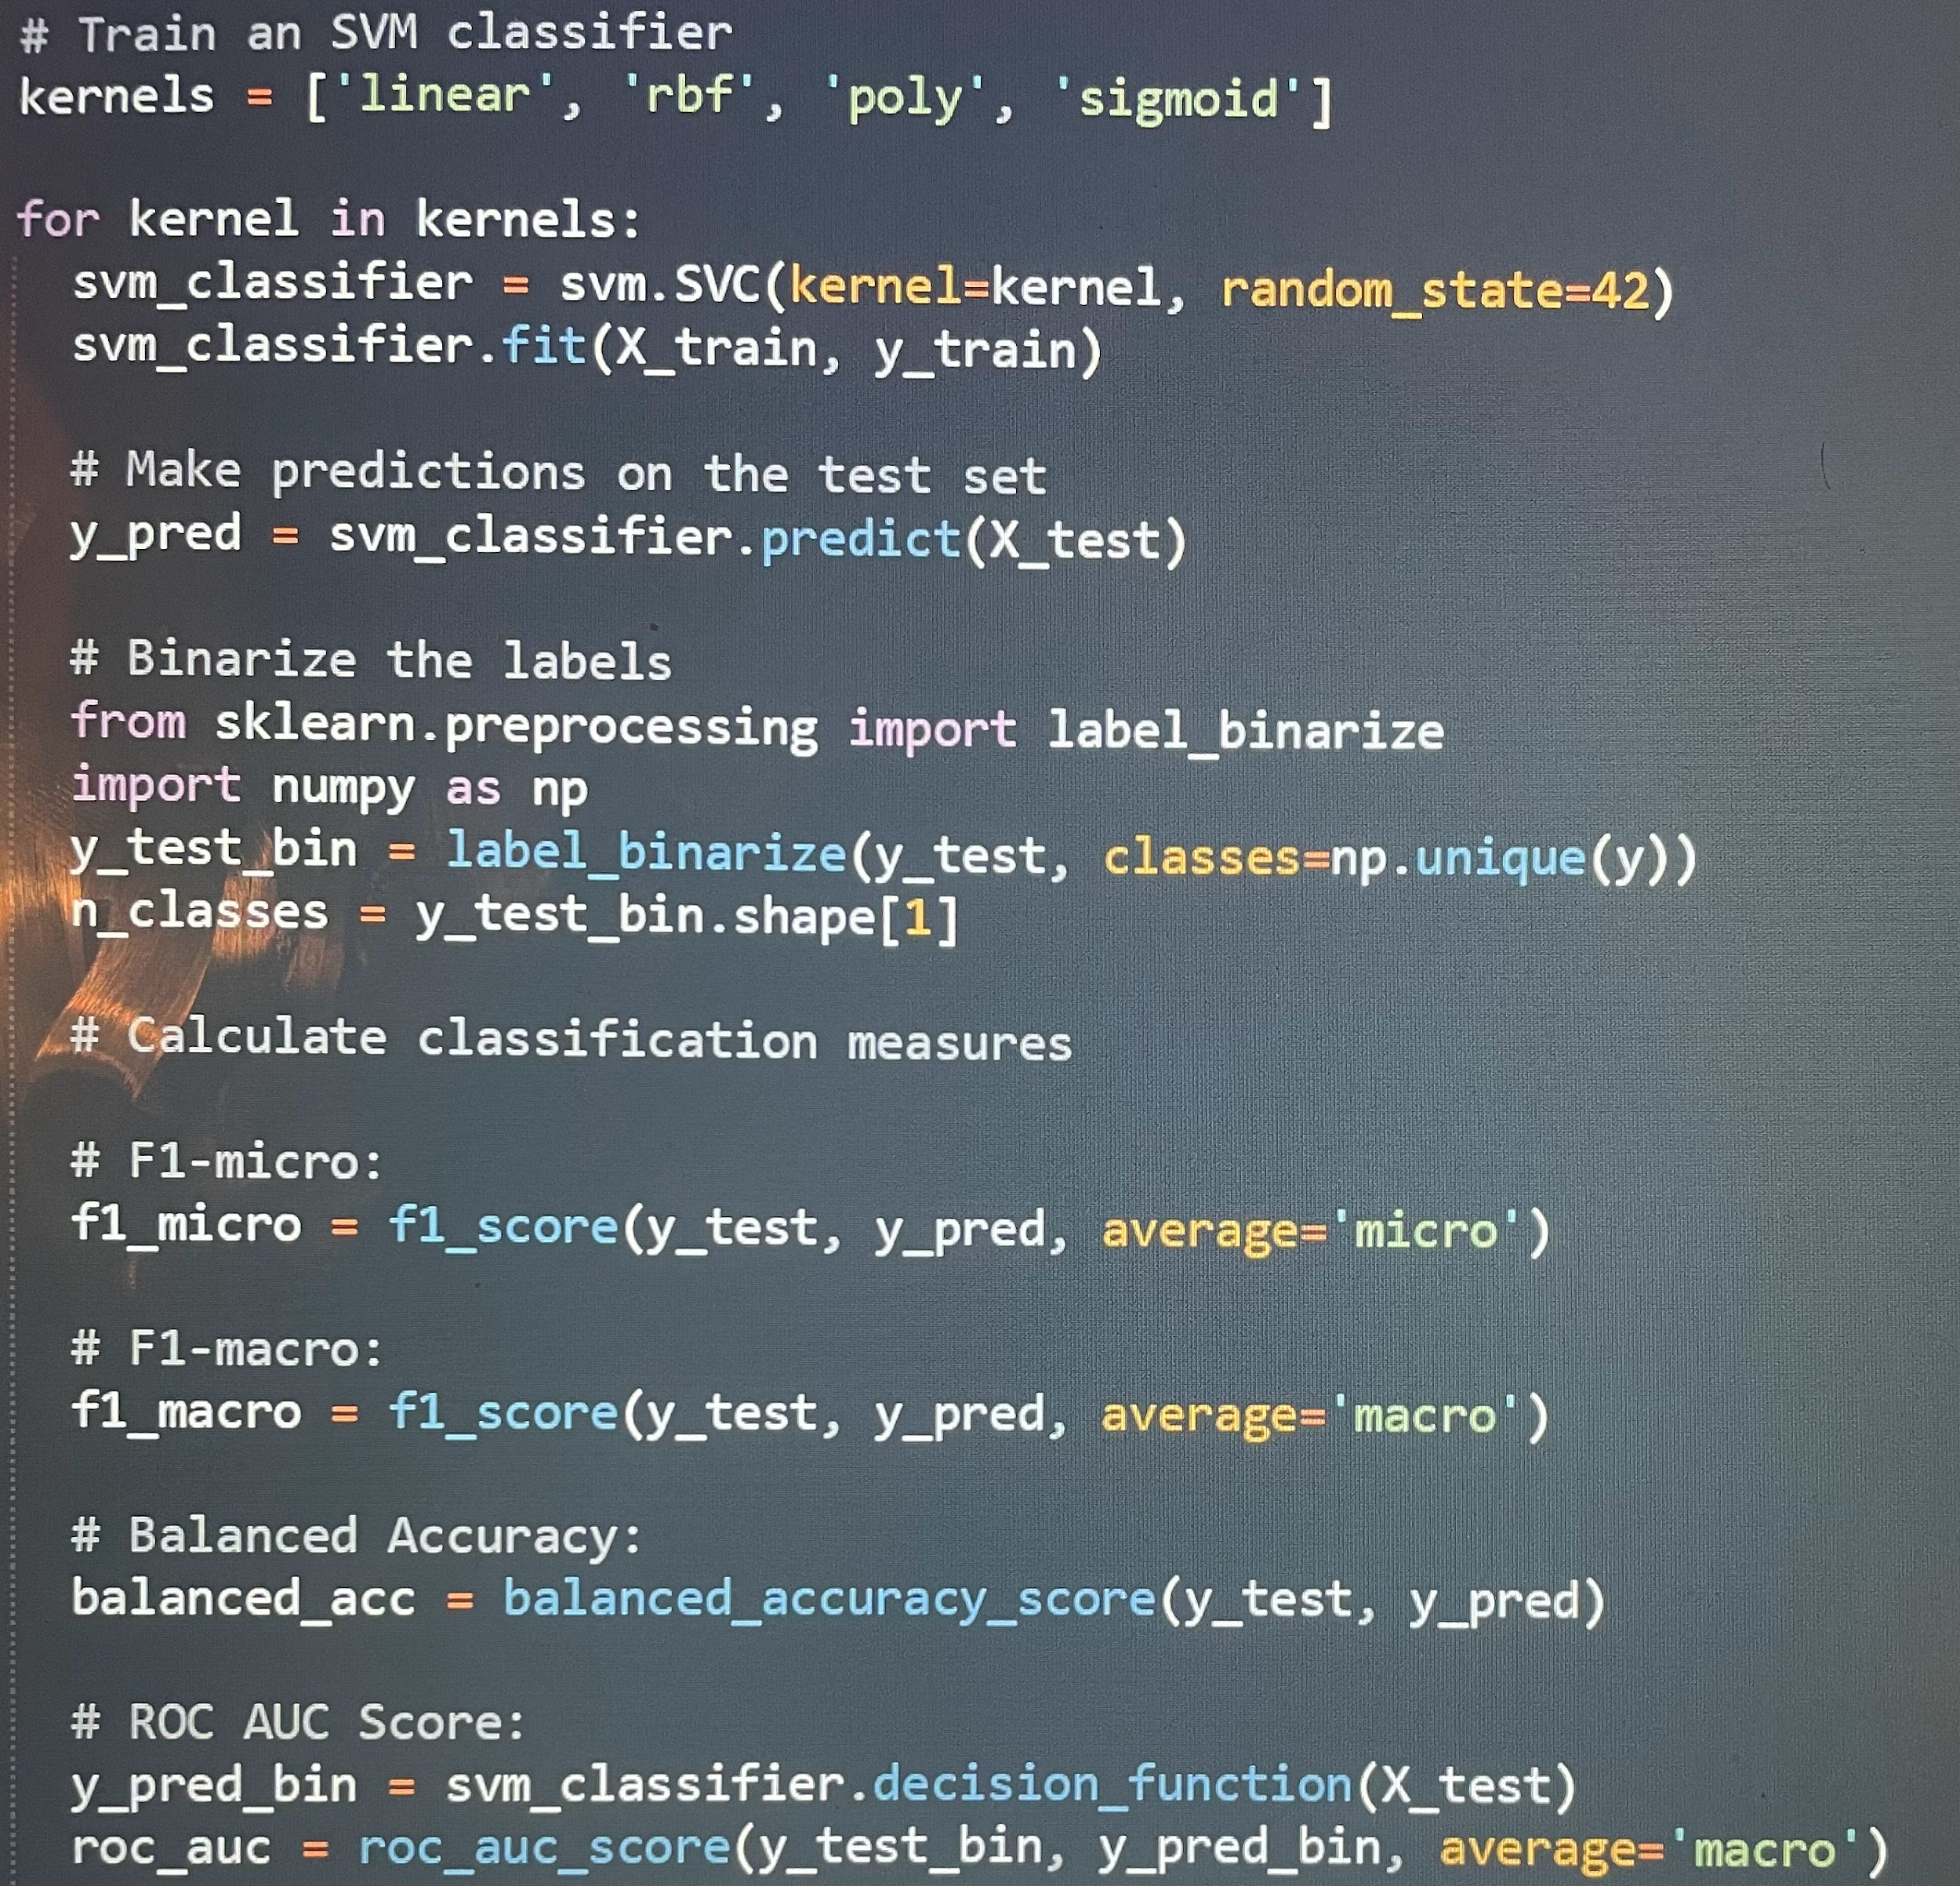
For Loop - SVM and Metrics

Slide 11
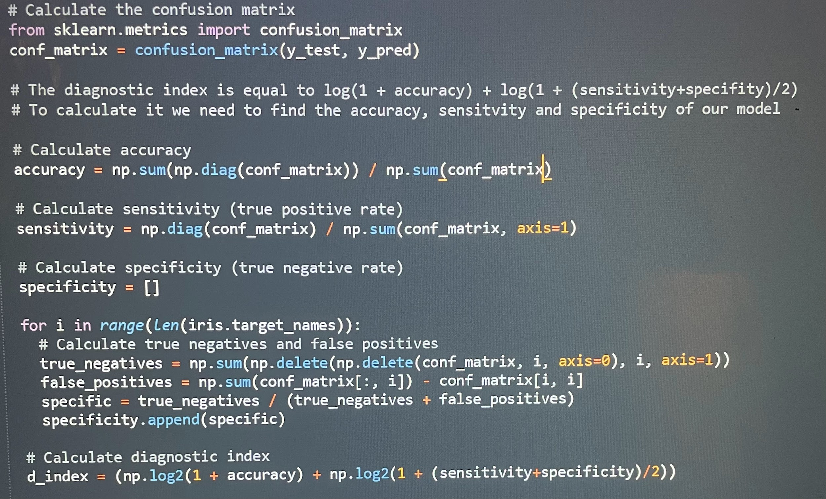
For Loop - Diagnostic Index

Slide 12
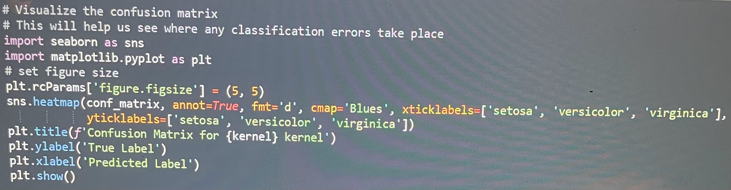
For Loop - Confusion Matrix Visualization

Slide 13
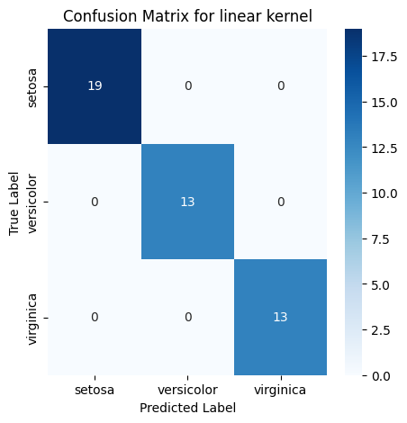
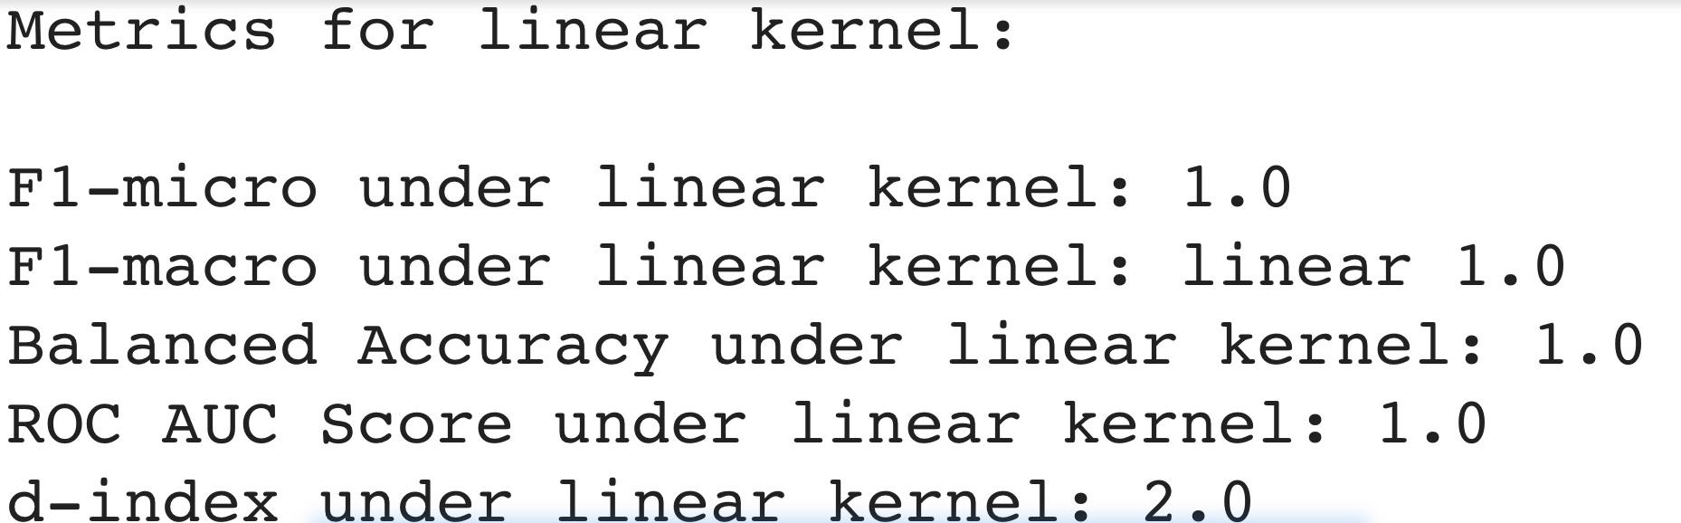
Linear Kernel - Confusion Matrix and Metrics

Slide 14
Linear Kernel - Confusion Matrix and Metrics
The metrics for the SVM using the linear kernel are perfect across the board
This suggests that the iris data is linear and potentially linearly separable

Slide 15
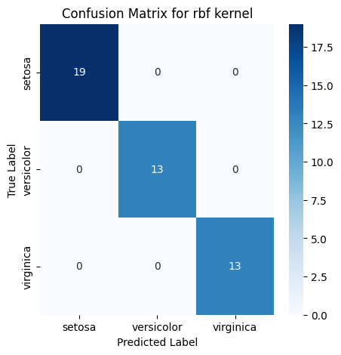
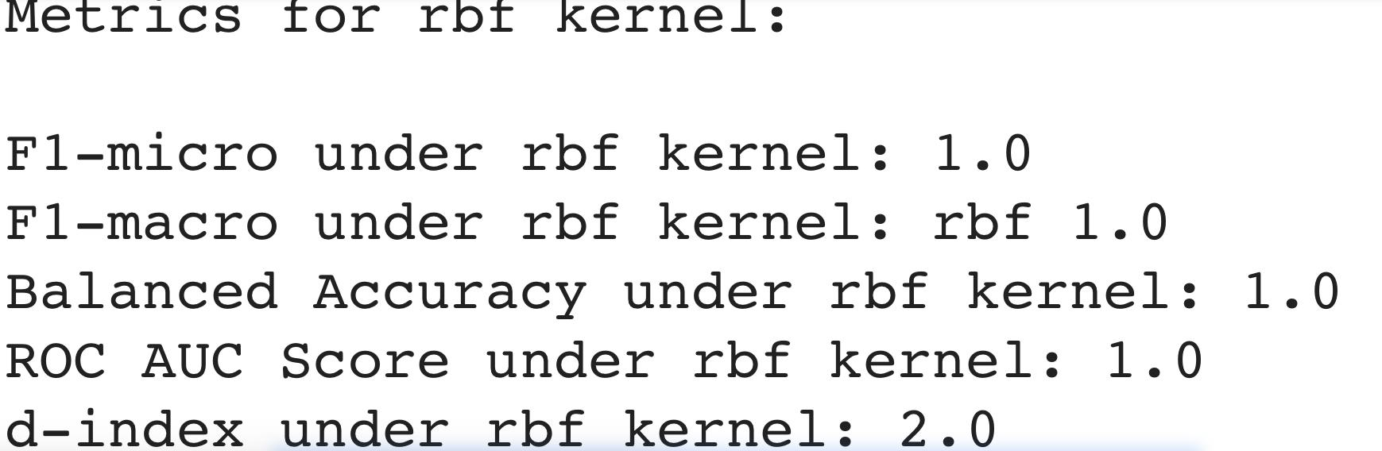
RBF Kernel - Confusion Matrix and Metrics

Slide 16
RBF Kernel - Confusion Matrix and Metrics
The SVM using the RBF Kernel also returns perfect metrics across the board
This is interesting because, typically using the RBF on linear data does not lead to spectacular metrics

Slide 17
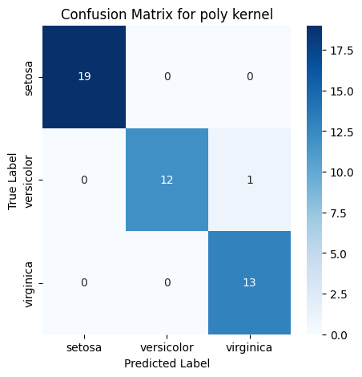
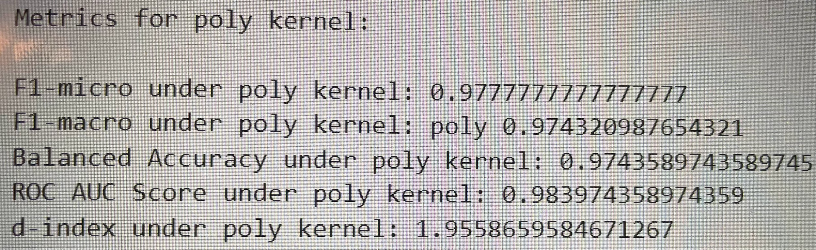
Polynomial Kernel - Confusion Matrix and Metrics

Slide 18
Polynomial Kernel - Confusion Matrix and Metrics
The metrics for the SVM using the polynomial kernel are all very high, but not perfect
As we see in the Confusion Matrix, the model only made one incorrect prediction
The model predicts one of the observations to be of virginica variety when it is actually

Slide 19
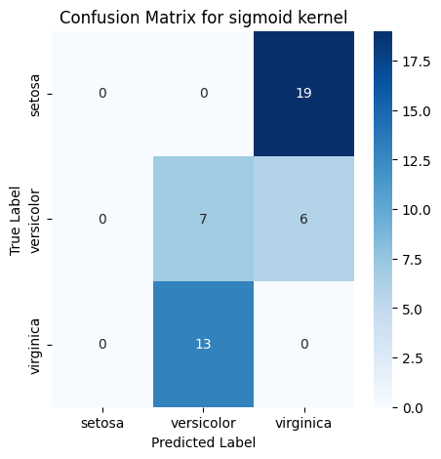
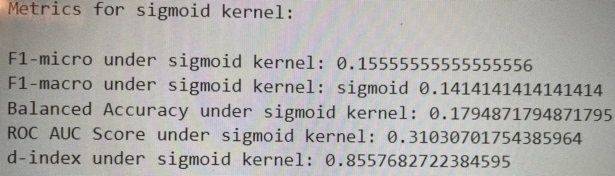
Sigmoid Kernel - Confusion Matrix and Metrics

Slide 20
Sigmoid Kernel - Confusion Matrix and Metrics
While the metrics for the other kernels are very high or even perfect, the same can not be said for the sigmoid kernel
Its only correct predictions are correctly predicting the versicolor variety 7 times
Most of the metrics at around 0.14 to 0.18 the ROC AUC score is about 0.31
The d-index here is only 0.86
It is very rare for the d-index to be less than one and this implies that the classification is worse than "chance level" classification under the sigmoid kernel

Slide 21
Metrics Visualization
We create a bar graph visualization that shows each metric score for each kernel, which are color-coded bars
Obviously, since a perfect d-index is 2 and has a different coefficient from the rest, it will stick out
Just because the d-index is ‘higher’ does not necessarily mean it is better than the other metrics
Since we are comparing the kernels to each other and not the metrics, it is not a huge issue

Slide 22
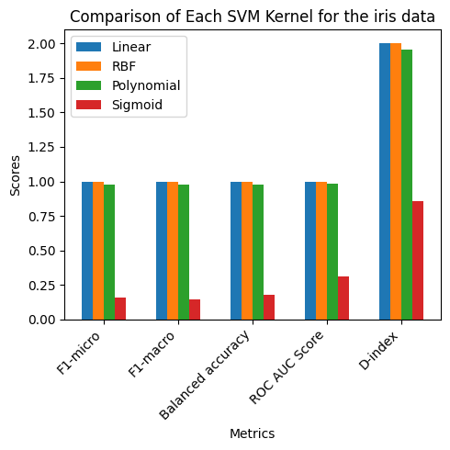
Metrics Visualization
The main takeaway from this visualization is
how poor the SVM with the sigmoid kernel is
at classification compared to all the other
kernels

Slide 23
Observations and Conclusions
The linear kernel having perfect metrics illustrates and emphasizes that the iris dataset is very well-separated and linear, potentially linearly separable
The rbf kernel also returning perfect scores further shows that the iris data is well-separated and can be easily classified or predicted by our SVM model
Typically, for potentially linearly separable data, the polynomial kernel is expected to return lower metrics than that of the linear kernel. However, here there isn't too much of a decrease
The sigmoid kernel drops the metrics quite a bit as it introduces much greater nonlinearity with a sigmoid curve that is not necessary for the linear structure of the iris data
Overall, aside from the sigmoid kernel, our SVM worked very well in classifying the variety of the iris data for each of the kernels, showing here that they are pretty much interchangeable despite the data appearing to be linear

Slide 24
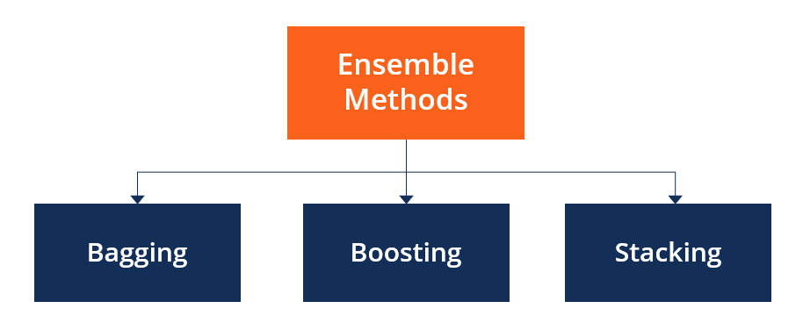

Part 2 - Bagging SVM with Credit and Cybersecurity Datasets

Slide 25
Data Import and Training
We import any packages we need as well as the three given datasets:
Credit_risk_small_data.csv
Credit_data_simulate.csv
cybersecurity_data.csv
We then write functions for bagging SVM implementation .returning SVM. and calculating the accuracy/ other metrics.
For this part of the analysis we split it into 80% training and 20% testing.
The training dataset will contain 120 observations and the testing will have 30.

Slide 26
Part 2 Objectives
Use first 80% data for training and the remaining 20% for test. Do SVM prediction.
Randomly pick 1/2 data from training data to form three training datasets: training_1, training_2, and training_3.
run SVM using training_1, training_2, and training_3 to predict the test data: we can them SVM_1, SVM_2, and SVM_3.
Determinate the final label for each test entry by doing the following voting.
Pick the predicted label with maximum votes, say 1 (svm_1), -1 (svm_2), 1 (svm_3), then final label should be 1.
Compare the performance of SVM and the Bagging-SVM for the two datasets and draw your conclusion.

Slide 27
Bagging-SVM
Bagging-SVM combines multiple SVM models trained on different subsets of the dataset.
It is used to help prevent overfitting and variance by averaging or voting on predictions of each of the SVM models.
In comparison to SVM, bagging-SVM offers improved stability and generalization by reducing overfitting and variance through ensemble averaging or voting.

Slide 28
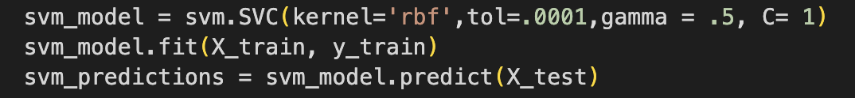
Objective 1
Here we assign 20% of the data to the training set.
Then we perform SVM prediction on the data.

Slide 29
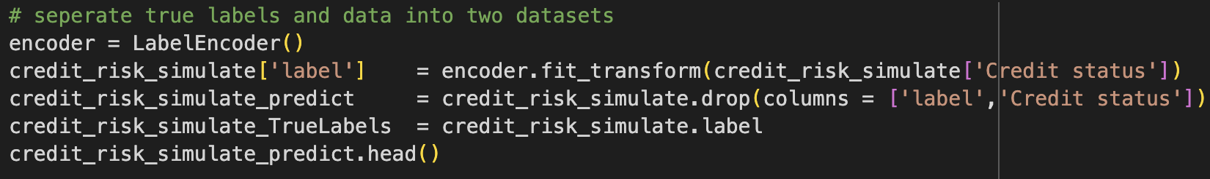
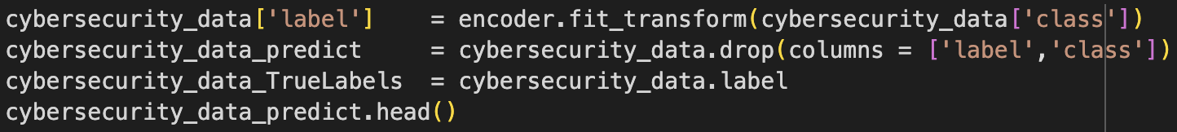
Objective 1 Data Splits
Dataset 1
Dataset 2
Dataset 3
For each, [file]_predict is used for X and [file]_Truelabels is used for y.

Slide 30
Objective 2
At random, half of the data from the training set of each data file is selected to form three new training sets.

Slide 31
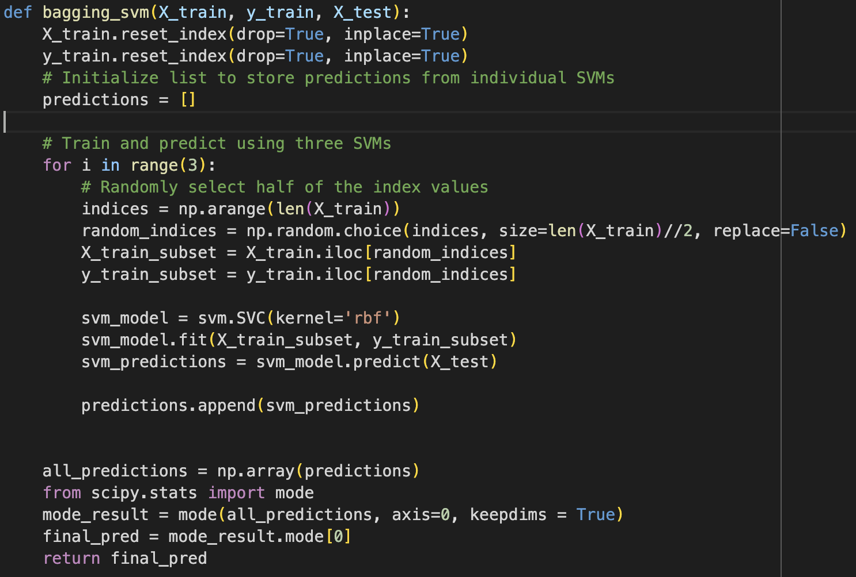
Objective 3
In this, we perform SVM training to predict the test data.
As seen, this is also where the previous two objectives for this part were performed as well.

Slide 32
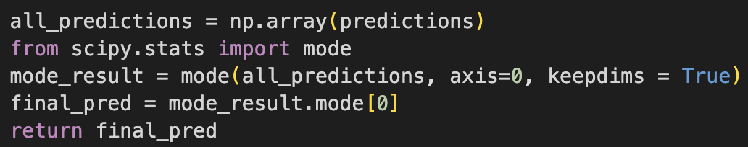
Objective 4
Here, the final label is determined for each test entry in our bagging-SVM function.

Slide 33
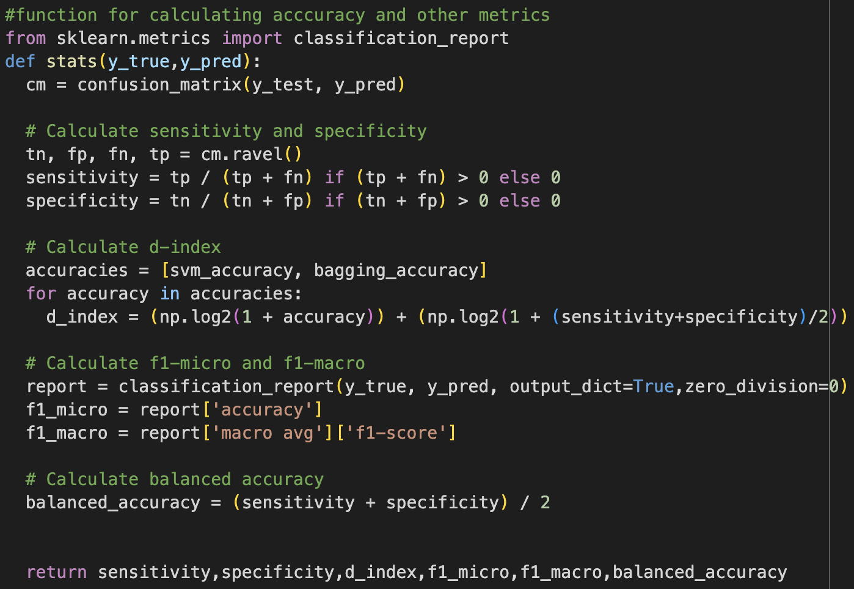
Objective 5
In this, we calculate the metrics (sensitivity, specificity, d-index, f1 micro and macro, and accuracy) of the datasets which is used to compare the normal SVM and bagging SVM values.

Slide 34
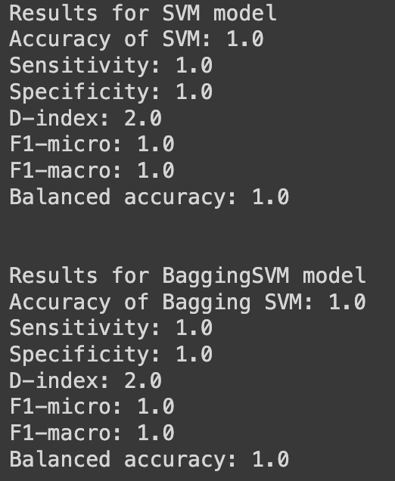
Objective 5 Results: credit_risk_simulate
As made evident in these results, the SVM and bagging-SVM results are the exact same for the credit_risk_simulate dataset.

Slide 35
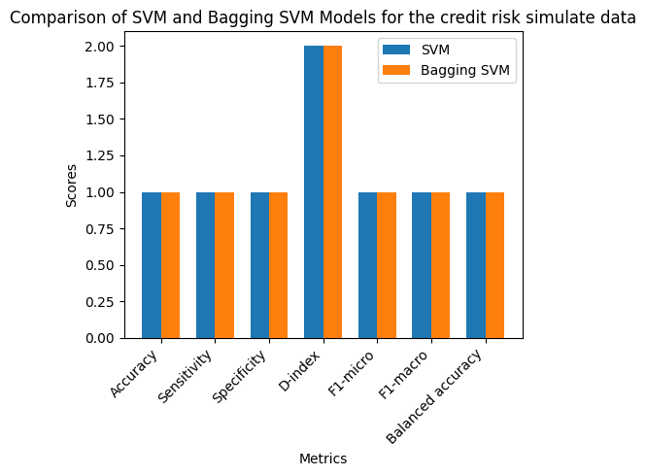
Objective 5 Results: credit_risk_simulate

Slide 36
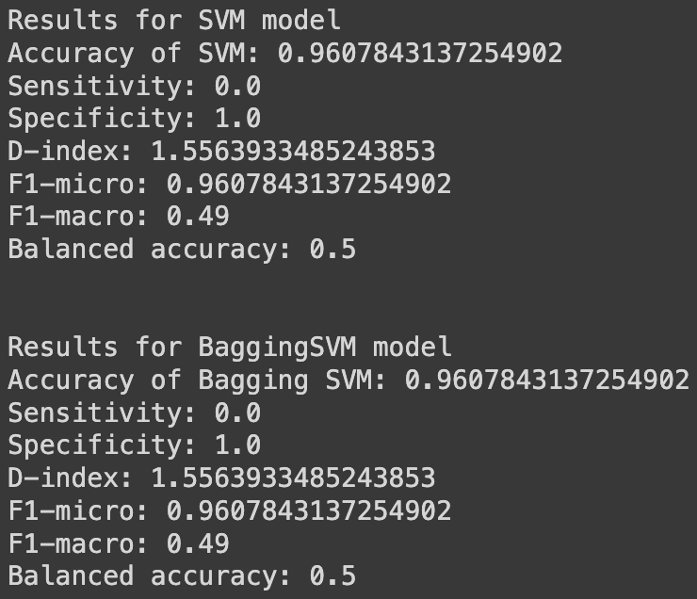
Objective 5 Results: cybersecurity_data
Again, as made evident in these results, the SVM and bagging-SVM results are the exact same for the cybersecurity_data dataset.

Slide 37
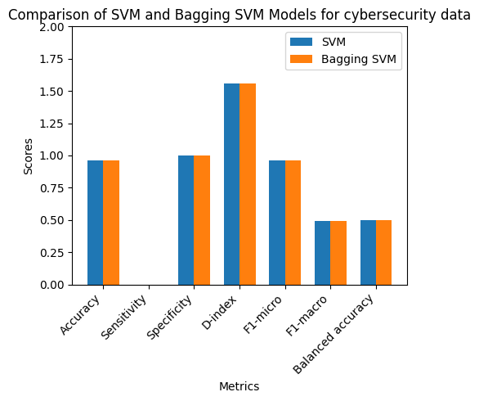
Objective 5 Results: cybersecurity_data

Slide 38
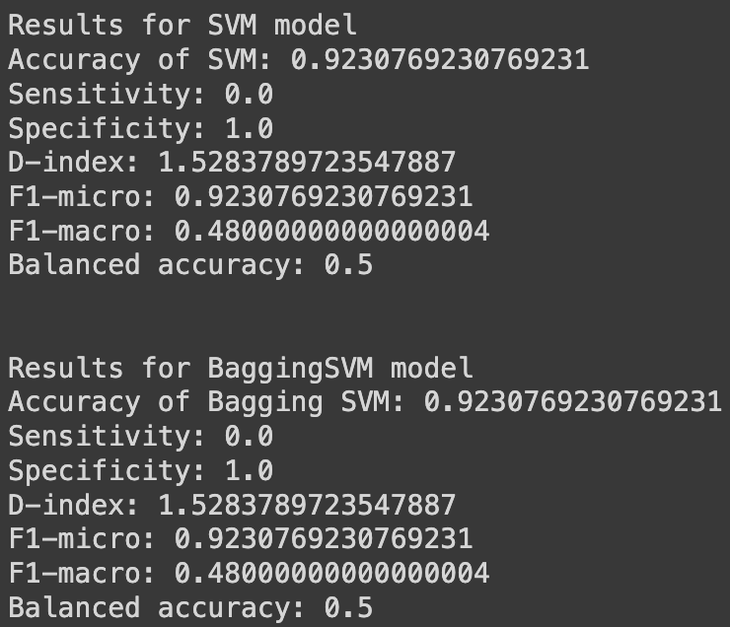
Objective 5 Results: credit_risk_small_data
Lastly, again made evident in these results, the SVM and bagging-SVM results are the exact same for the credit_risk_small_data dataset.

Slide 39
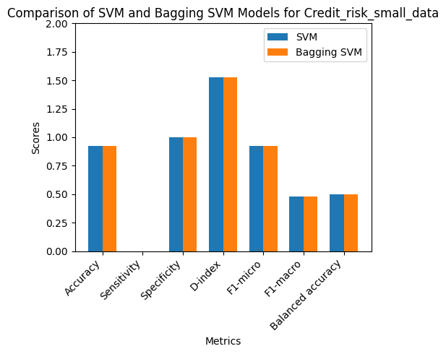
Objective 5 Results: credit_risk_small_data

Slide 40
Objective 5 Conclusion
After performing SVM and bagging-SVM on each of the datasets, we have discovered that they generated the same results for each of the metrics in all cases.
Some conclusions that can be drawn from this result is as follows:
Both SVM and bagging-SVM have similar performance on these datasets
Since bagging-SVM didn’t provide an advantage over SVM, the datasets may have been well-defined, not having noisy features / high variance.
Since bagging-SVM helps with overfitting and yielded the same results as SVM, overfitting was not a problem within the datasets.
While bagging-SVM is more complex than normal SVM and produced the same results, using the normal SVM would be better to use in this case as it is just as effective without the added complexity brought along with bagging-SVM.

